Slide 1
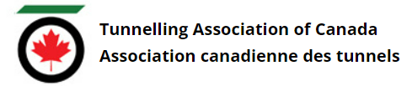
Tunnelling Association of Canada
Equity, Diversity, and Inclusion Moment​
Indigenous Peoples in Canada
Date

Slide 2
Tunnelling Association of Canada
Indigenous Peoples in Canada
The term “Indigenous” refers to people living on a land inhabited by their ancestors since time immemorial.
In Canada, the term “Indigenous Peoples” refers to three distinct groups:
First Nations,
Métis, and
Inuit peoples.
Terms “Indian”, “Native”, and “Native Canadian” have negative and colonial connotations.
2

Slide 3
Tunnelling Association of Canada
Indigenous History and You
Seek education on Indigenous history to further your understanding of current realities
Learn of and acknowledge your presence on Indigenous Lands (https://native-land.ca/)
Implement corporate sector responsibilities from Call to Action #92 (Truth and Reconciliation Commission of Canada: Calls to Action report) through:
    Project consultation and engagement with Indigenous Peoples
    Equitable access to jobs, training, and education for Indigenous Peoples
    Provide education on the history of Indigenous Peoples for employees
3

Slide 4
Tunnelling Association of Canada
Date
Thank you!
The End

